Slide 1
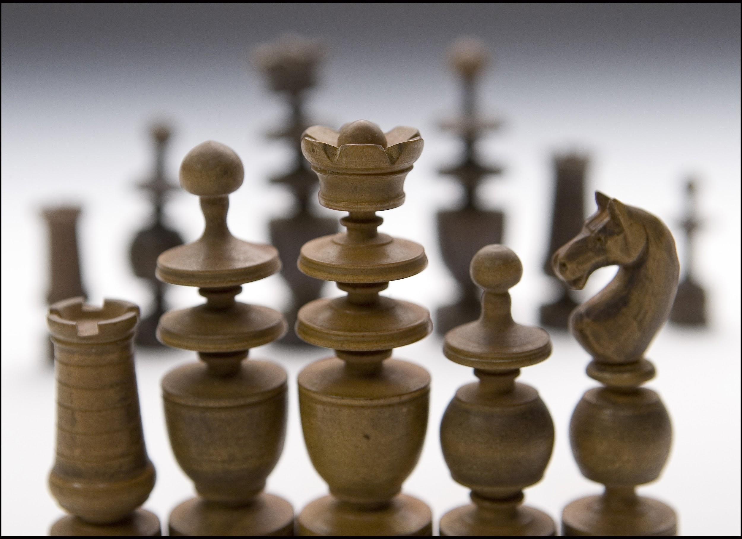
Chess Data Capstone two: Project
Derek Sullivan

Slide 2
Project Objectives
“What are we trying to determine?”
Determine what makes great players so good: Discovering the patterns and tactics of highly skilled players will help anyone with intentions to become a great player.
See how lower ranking people behave: We can assume that lower level players have worse habits than higher level players. This will make the differences between the top skill group and find pitfalls to be avoided by any player.

Slide 3
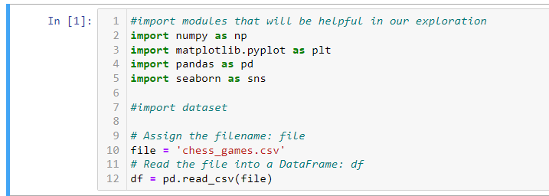
Data Wrangling
Kaggle.com
(Chess Dataset)
Download as .csv file
Load into pandas DataFrame

Slide 4
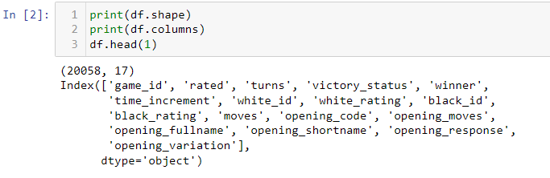
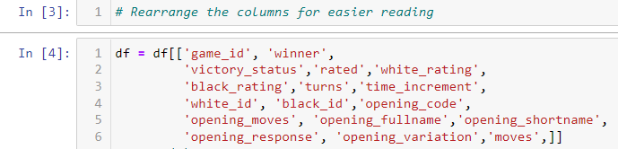
Data Organization
Import data, check the format: 17 Columns and 20,058 Rows in the DataFrame
Re-Order these for easier reading

Slide 5
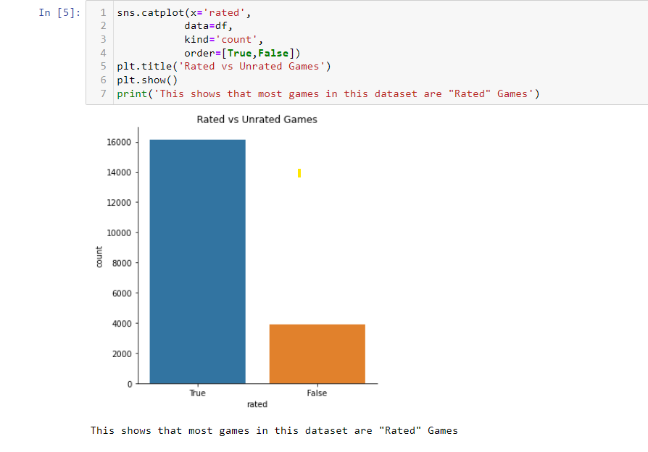
Data Organization:
How games are divided
What parts of this data are important? How do we get rid of data that isn’t useful?

Slide 6
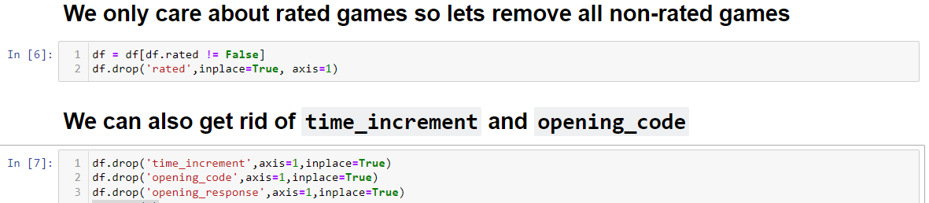
Data Organization
Editing the data:
Dataframe slicing and using df.drop()
Only keep the rated games and get rid of redundant and useless data

Slide 7
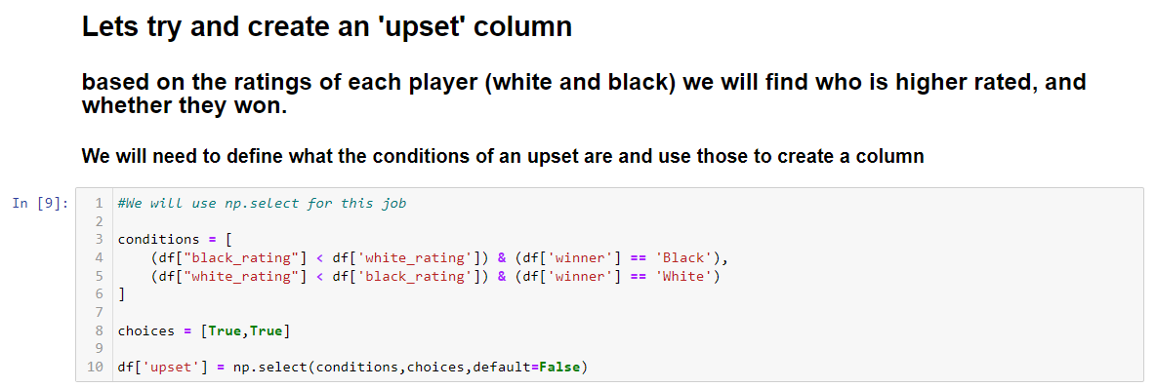
Data Definition
Using np.select() to create a new column based on multiple conditions
Create conditions and choices and plug them in
Creating bool data based on multiple conditions

Slide 8
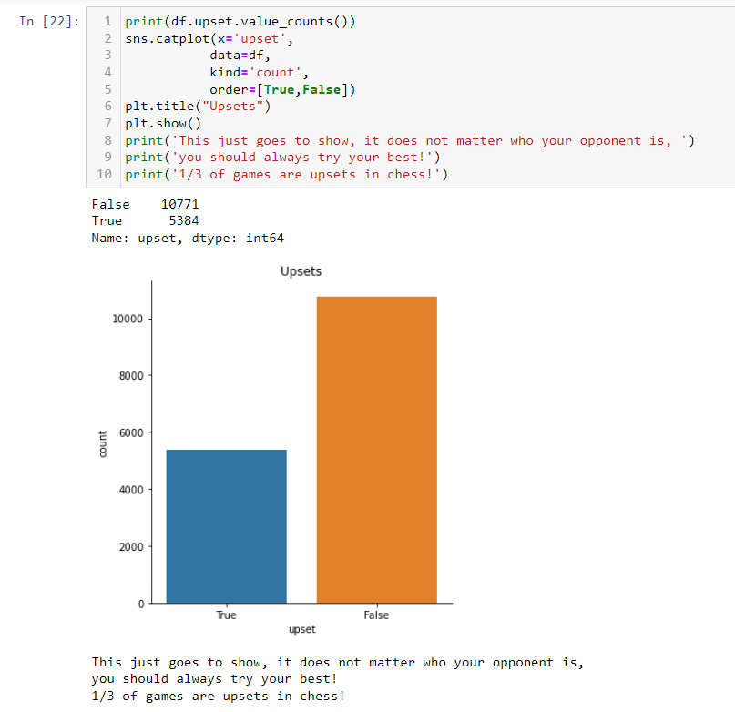
Data Definitions:
Drawing insights from new data:
⅓ of the games are upsets

Slide 9
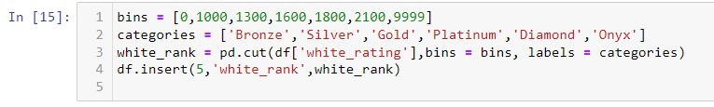
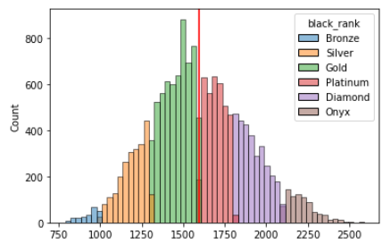
Data definitions:
Creating categories from rating data
Creating categorical data based on conditions
Created 6 distinct categories based on skill level

Slide 10
Data cleaning
Removed redundant columns
Determined what was important to figuring out our goals
Determined data did not contain null values and each column was appropriately data typed

Slide 11
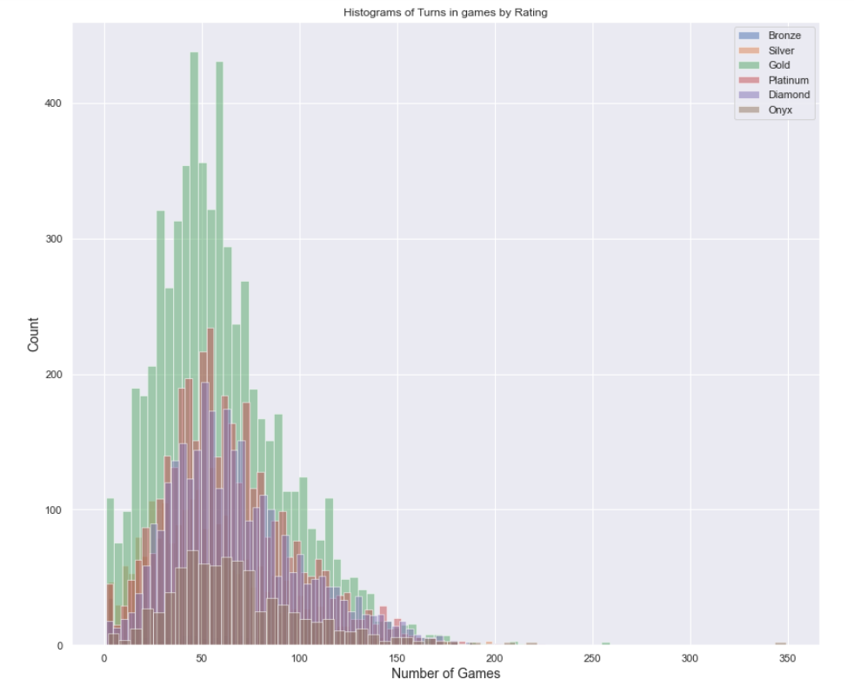
Findings: Number of turns to win did not vary between skill groups
(overall median of 57)

Slide 12
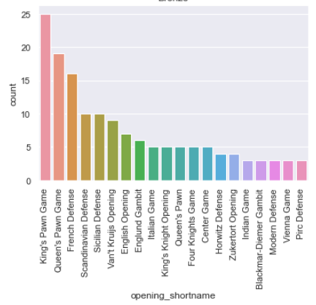
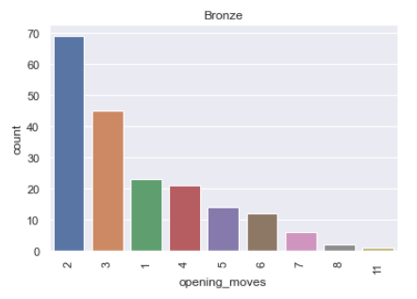
Findings: Bronze Players
Now let's start with Bronze, our lowest category. These players are ranked up to 1000 which is considered beginner in the chess community. These games represent 1.4% of games in this dataset (the smallest section of data). Bronze players most commonly open with King (13%) and Queen's Pawn (9%) games, and follow those patterns for an average of 3.06 moves (2 moves being the most frequent option) before doing something "on their own", or not following the sequence

Slide 13
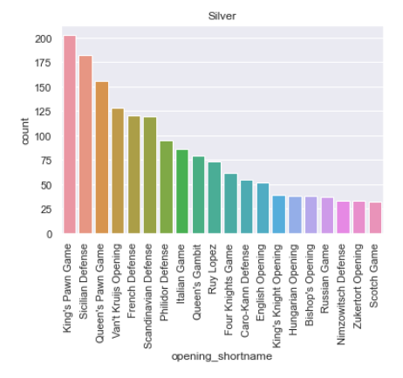
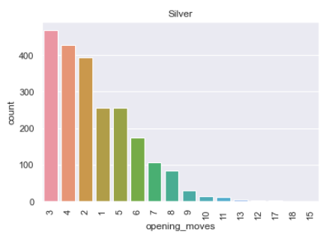
Findings: Silver players
Now let's look at Silvers. These are people rated between 1000 and 1300. This is considered an amateur rating. Games at this skill level are 14% of the games in the dataset. Silvers have a larger variety of options they play with (likely unknowingly) and commit to their openings longer than Bronzes, and average of 3.8 moves with 3 being the most frequent.

Slide 14
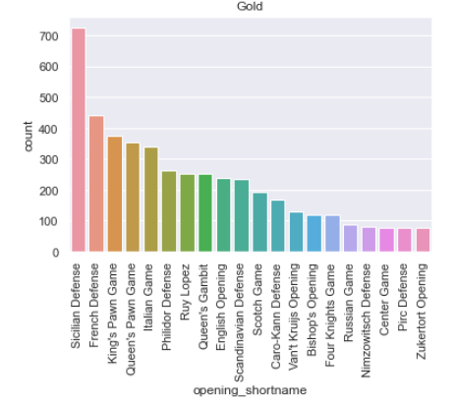
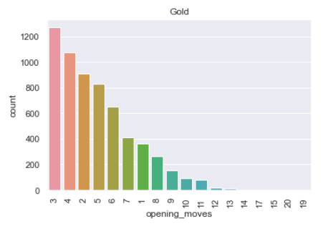
Findings: Gold players
Now let's look at Gold. Golds are rated between 1300-1600 and are "good" players. These aren't tournament winners or grandmasters but will definitely beat anyone in the general population. This is by far the largest chunk of players in this dataset, representing 38% of games in the dataset.

Slide 15
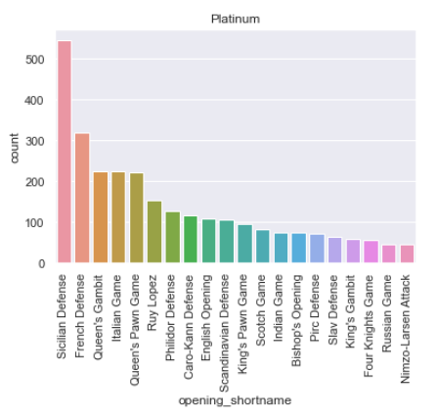
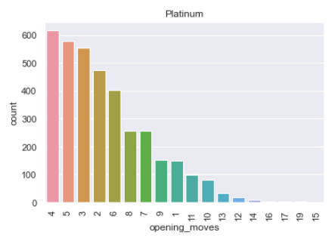
Findings: Platinum players
Time to analyze Platinum, a group of very strong players. They are ranked between 1600-1900 and represent advanced players. These are people who may not have made it professionally but are truly gifted at the game. They represent 22.4% of the player base.Platinum ranked players commit to their opening an average of 5 moves with 4 moves being the most repeated number. They use the Sicialian defense opening twice as much as any other opening.

Slide 16
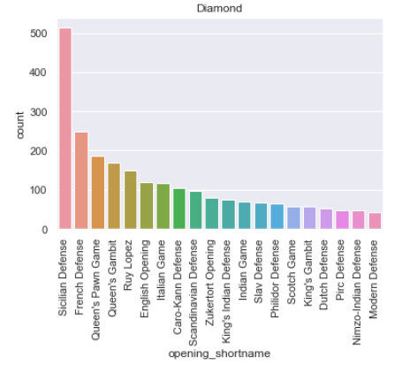
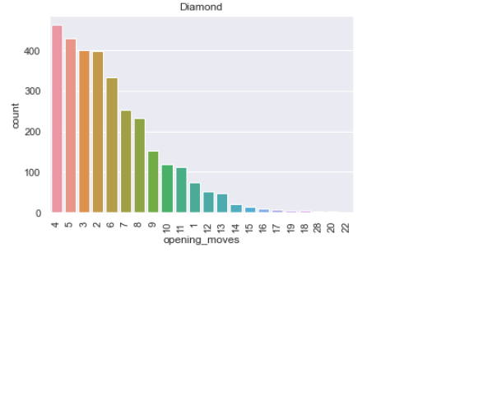
Findings: Diamond players
Now lets look at diamonds, our second to the top group. They represent players from 1800-2100 rating bracket and are tremendously skilled players. They represent 19% of the dataset. Diamonds have an average of 5.67 opening moves before diverting, and use the Sicilian Defense 16.4% of the time, with the second most often being French Defense which is around 8%.

Slide 17
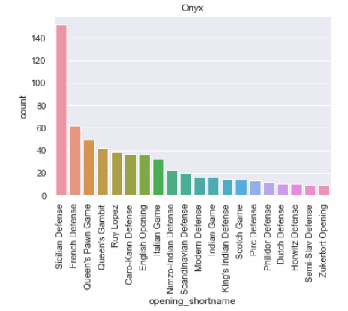
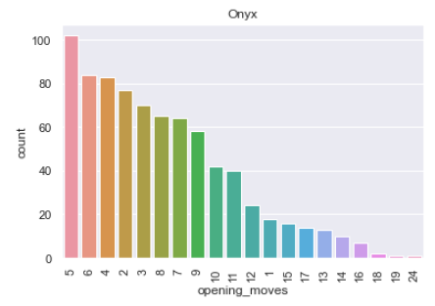
Findings: Onyx players
Now lets look at our highest rated skill group, Onyx. These are players ranked 2100+ to put this in perspective, Magnus Carlson, the highest rated player in the world is a 2800. These are exceptional players who are brilliant and make very very few mistakes. Games at this skill rating represent a little less than 5% of the games in this dataset. Onyx level players love the Sicilian Defense and stick to it, averaging 6.7 opening moves before making a variation from the 'book'.

